Slide 1
STL ODA Components
STL
Network Software Wireless
09-Dec-2022

Slide 2
Agenda
STL Digital BSS ODA Components Architecture
ODA Canvas on STL Cloud Native Platform (CNP) for Private Telco Clouds
STL Digital Policy Control & Charging (dPCC) : Product Rating and Service Balance Management ODA Components
Demonstration of STL dPCC Compliance to ODA Canvas L1, L2 Tests

Slide 3
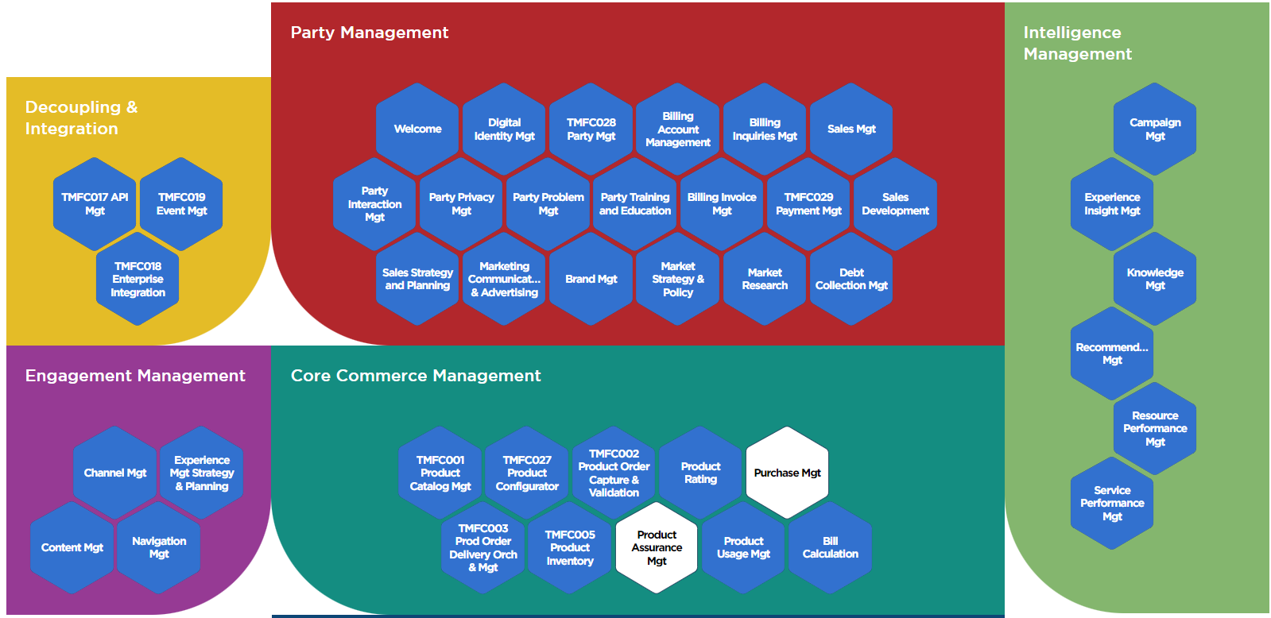

STL Digital BSS ODA Components Architecture
Representation across Engagement Management, Integration, Party Management, Core Commerce Management, Production and Intelligence Management (Blue Hexagons in STL Scope)
TMF Open API and ODA Component Accelerator Participant
Deployment of ODA Canvas on STL Cloud Native Platform (CNP)
Compliant with TMF ODA L1-Static, Dynamic and L2-Static, L2-Dynamic requirements. (Golden Component Proof of Concept with TMF Certified STL TMF 654 Prepay Balance Management in dPCC Service Balance Mgt ODA Component – TMFC013)
Contribution to ODA Canvas Integration on Private Telco Clouds beyond Public Clouds

Slide 4




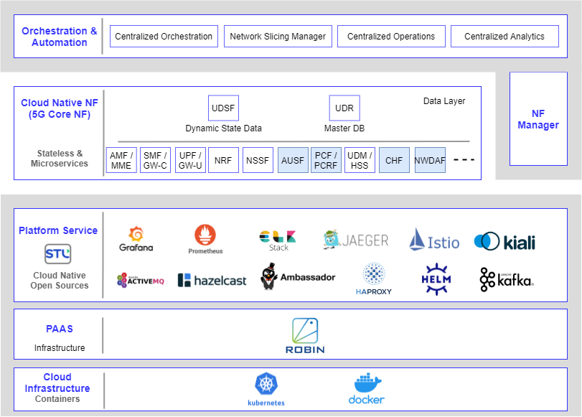























ODA Canvas on STL Cloud Native Platform (CNP) for Private Telco Clouds
Run all application workloads on STL CNP with ODA Canvas Kubernetes Operators
Application Workloads
Enterprise Applications
(Cloud Native Applications)
Digital MarketPlace
dBSS
SDN-NFV Applications
(CNFs)
API Manager
dPCRF
5G PCF
Intellza
IPLMS
dSP
dPCC
dWiFi
…
dMediation
CGF/CGNAT
5G CHF
…
BSS/OSS (CNFs)
Telco Network Applications (VNFs/CNFs)
Big Data / Data Analytics
Platform Services – STL CNP
CI/CD
Monitoring, Alerting, Logging, Tracing, Service Mesh, Messaging, Caching, IAM, Message Queues, Security, API GW, Load Balancer, Container Packaging, Container Registry Services
Component
Controller
Security
Controller
ODA Canvas Services
API
Controller
Component CRD
Webhook
PaaS – STL CNP
Kubernetes
Virtual Networking
App-workflow Manager
IaaS+
Private Cloud
Public Cloud
Any Virtualization
Virtual Private Cloud
IaaS
COTS Server

Slide 5
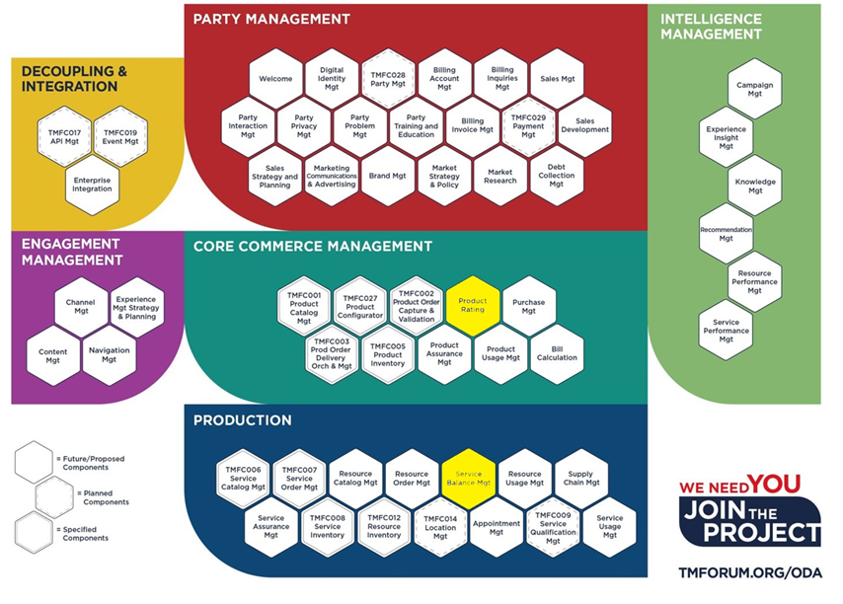
STL dPCC : Product Rating, Service Balance Mgmt Components
STL Digital Policy Control & Charging (dPCC) enables
4G PCC (dPCC-Netvertex component name) and 5G PCF (PCF-Netvertex component name)
Product Rating and Service Balance Management (TMFC013) ODA Components
TMFC013 Service Balance Management as STL TMF Golden Component for Proof of Concept
TMF Certified STL TMF 654 Prepay Balance Management API as Exposed API for Golden Component
STL dPCC and STL PCF on ODA Canvas over STL Cloud Native Platform Runtime environment
ODA Component Envelopes definition for STL dPCC and STL PCF
Successful L1 and L2 Static and Dynamic Tests (with STL dPCC Service Balance Mgt ODA Component for Proof of Concept)
Demo URL for Compliance of STL dPCC to ODA Canvas L1, L2 Tests : https://drive.google.com/file/d/1klPsuYGLWbbapEh88EfDwVKXKz3OibK5/view
Modules of STL dPCC

